Slide 1

CSE 4208 : Computer Graphic Laboratory
A Restaurant’s Multipurpose Kitchen
Presented To:
Dr. Sk. Md. Masudul Ahsan
Professor
Md. Badiuzzaman Shuvo
Lecturer
Department of Computer Science and Engineering Khulna University of Engineering & Technology
Presented By:
Doniel Tripura
Roll: 1907121
Department of Computer Science and Engineering Khulna University of Engineering & Technology

Slide 2
Outlines
Introduction
Objectives
Tools Used
Textures
Snapshots

Slide 3
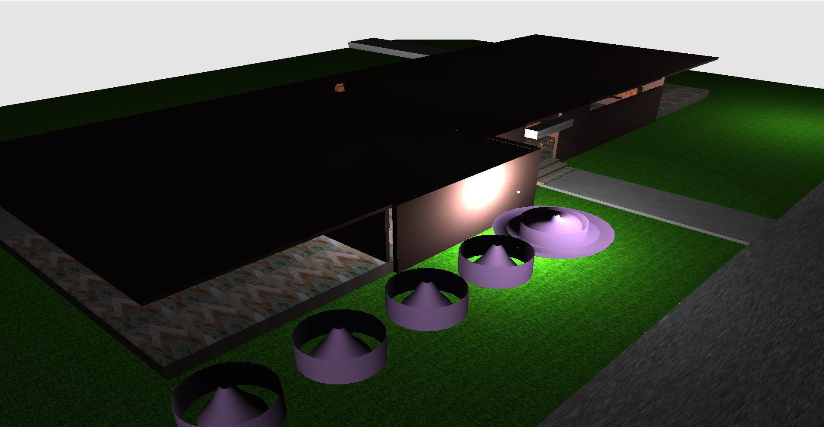
Introduction
A 5 star Restaurant’s Kitchen both visually stunning and highly interactive and is designed and implemented using openGL 3.3.
Figure 1:- 3D Complete View of the restaurant

Slide 4
Objectives
The objectives of the project are:
To design different types of shapes and implement different types of operations.
To learn about shading and rendering.
To gain and apply knowledge of OpenGL for 3D simulations.

Slide 5
Tools Used
The following tools are used to build the project
OpenGl(3.3): Rendering 2D and 3D graphics.
Glad: Glad is a straightforward and simple loader generator that manages OpenGL function pointers, enabling easy and efficient management of OpenGL
GLFW (Graphics Library Framework): Window creation and handling input (keyboard, mouse).
GLEW (OpenGL Extension Wrangler): It mainly manages the openGL extentsion.
stb_image: For loading image.

Slide 6
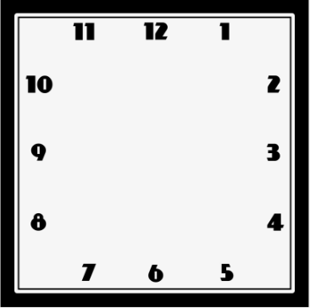

Textures
Figure 2: Kitchen’s Logo
Figure 3: Clock texture

Slide 7
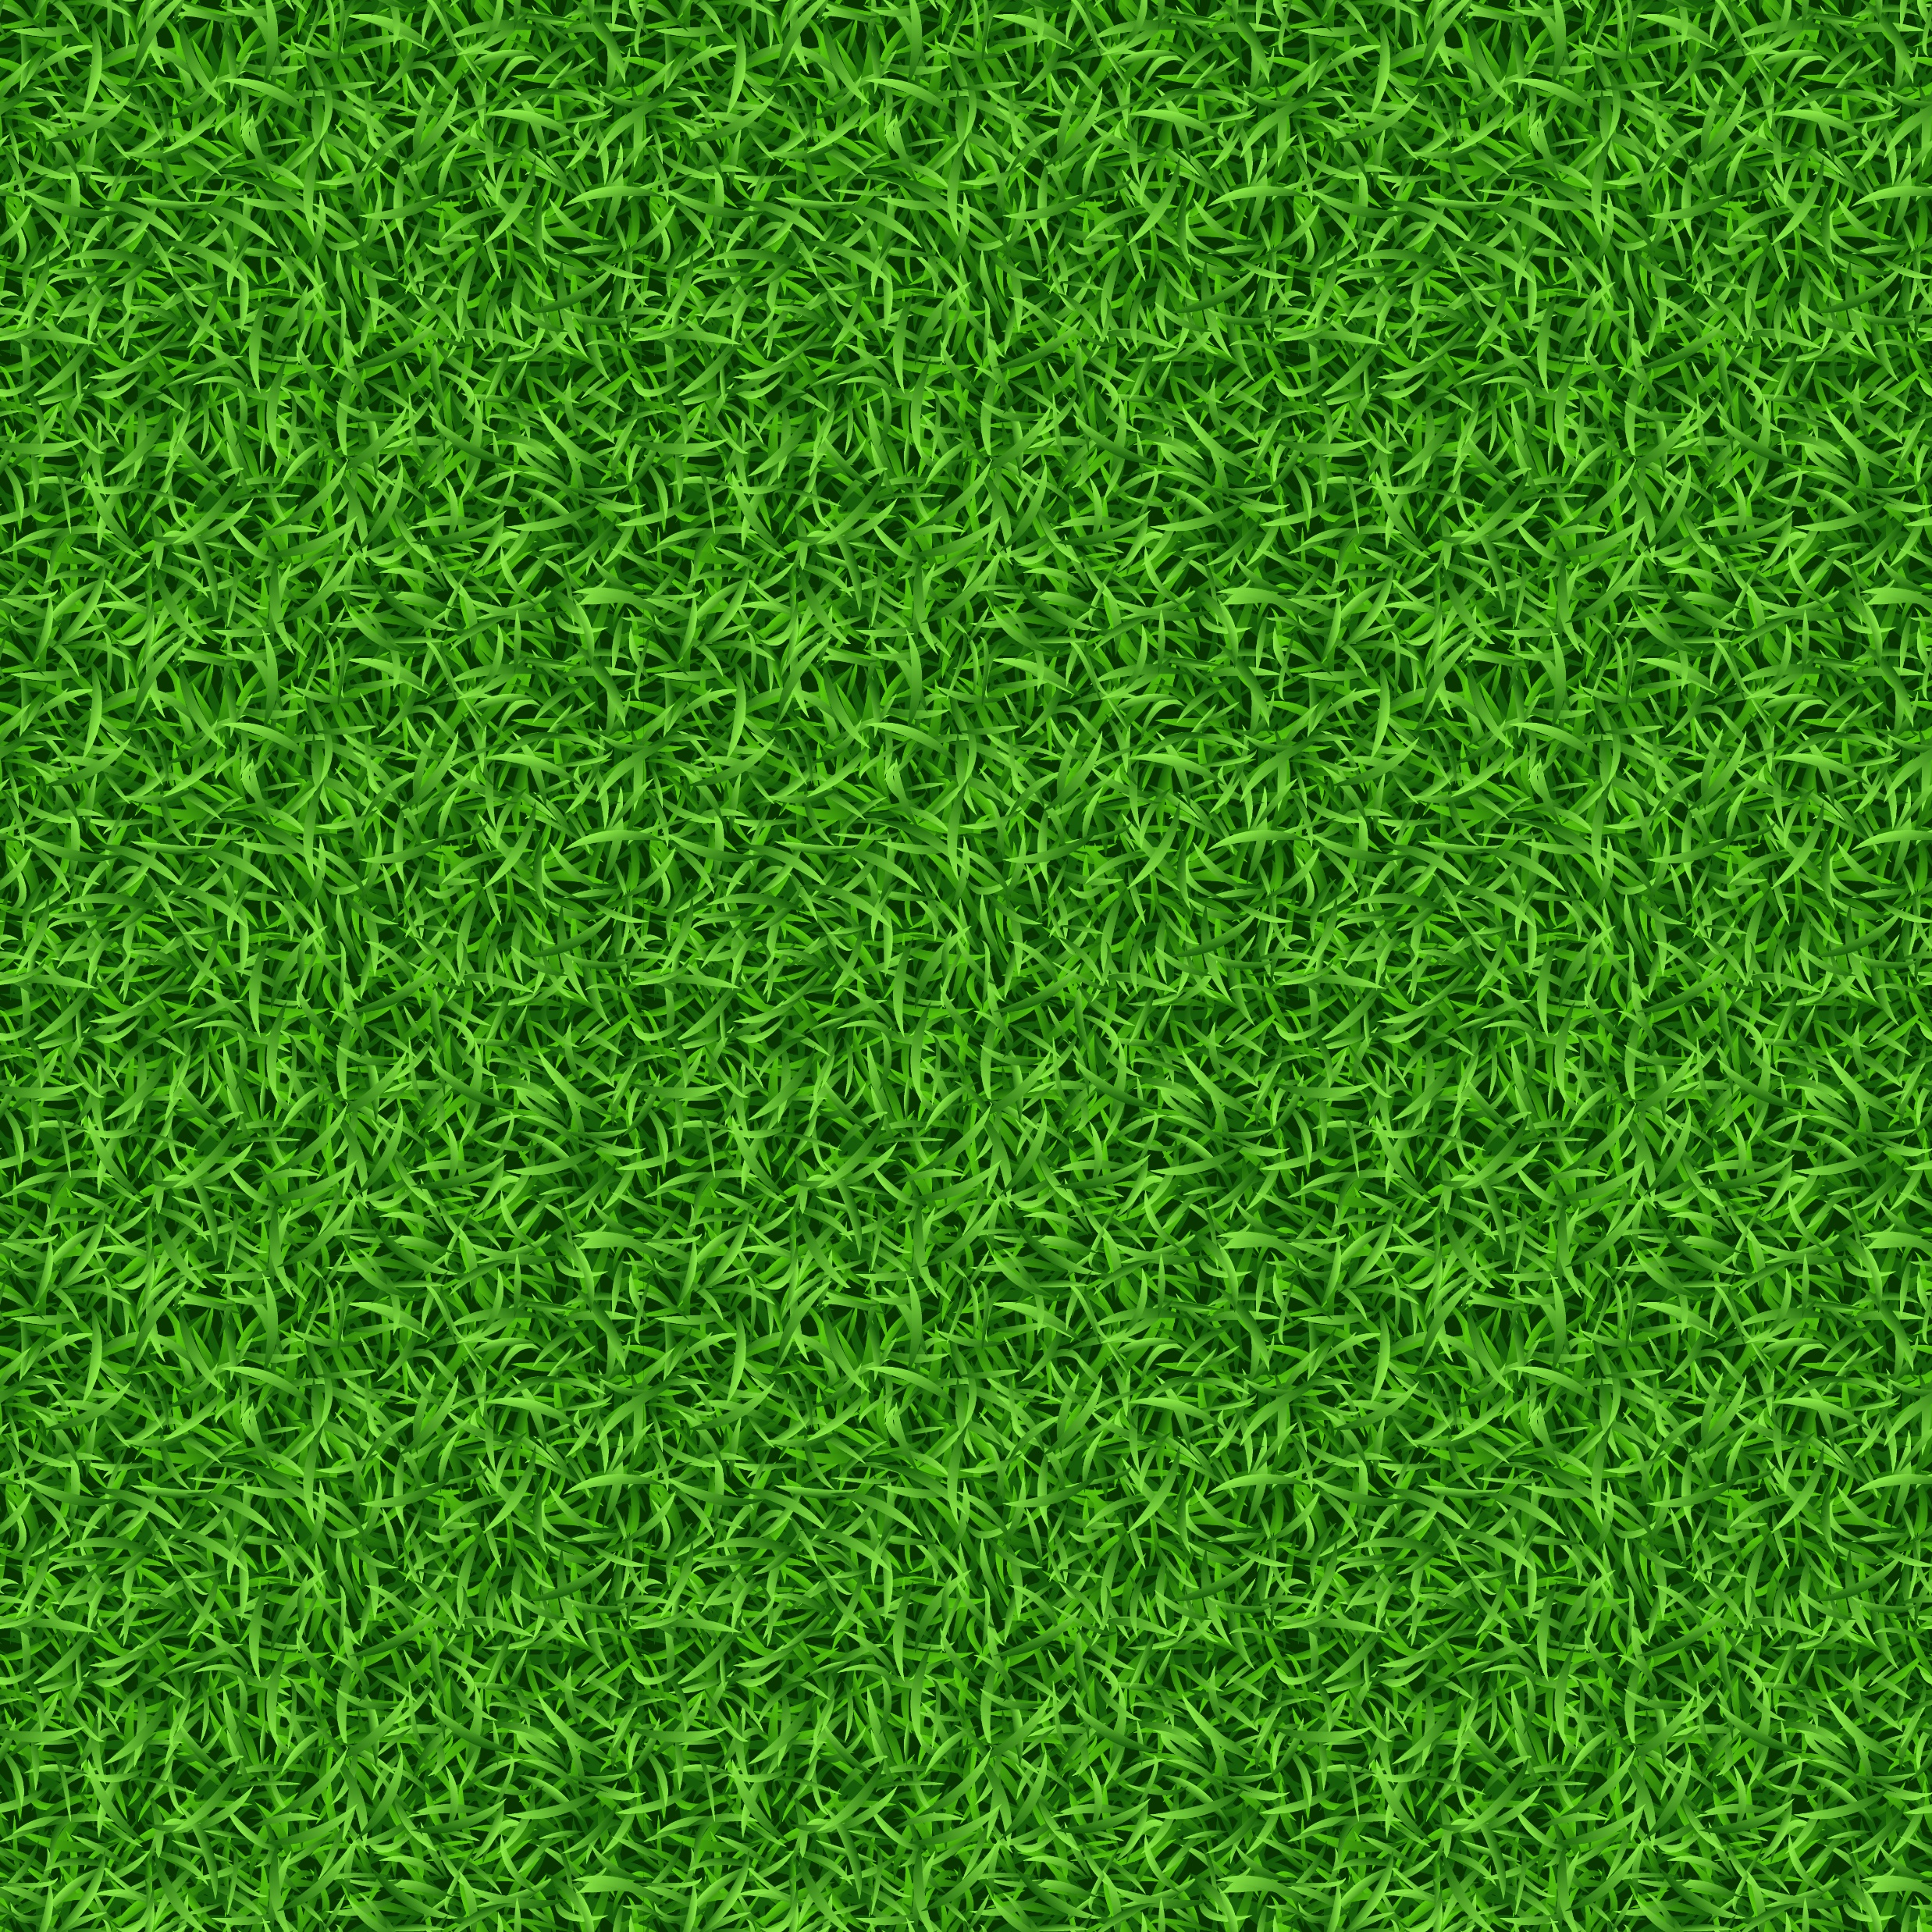
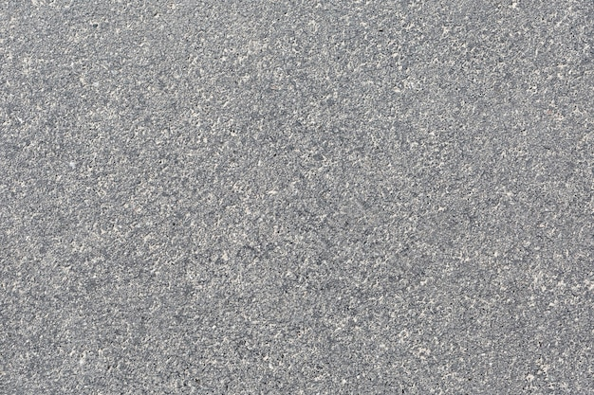
Textures (Cont.)
Figure 4: Grass Texture
Figure 5: Road Texture

Slide 8

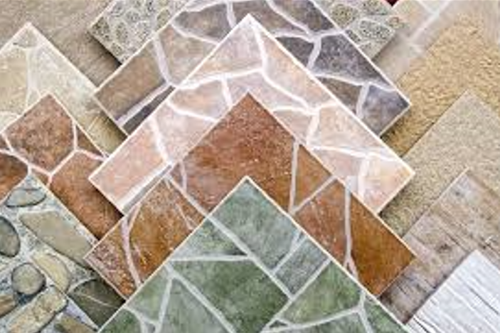
Textures (Cont.)
Figure 6: Wood texture for chair and table
Figure 7: Floor texture

Slide 9
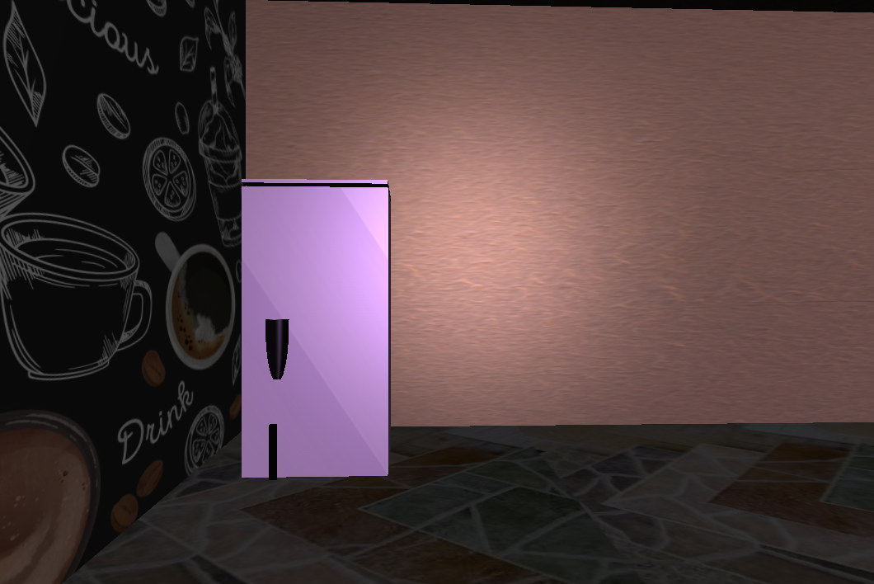
Snapshots
Figure 8: Kitchen View

Slide 10
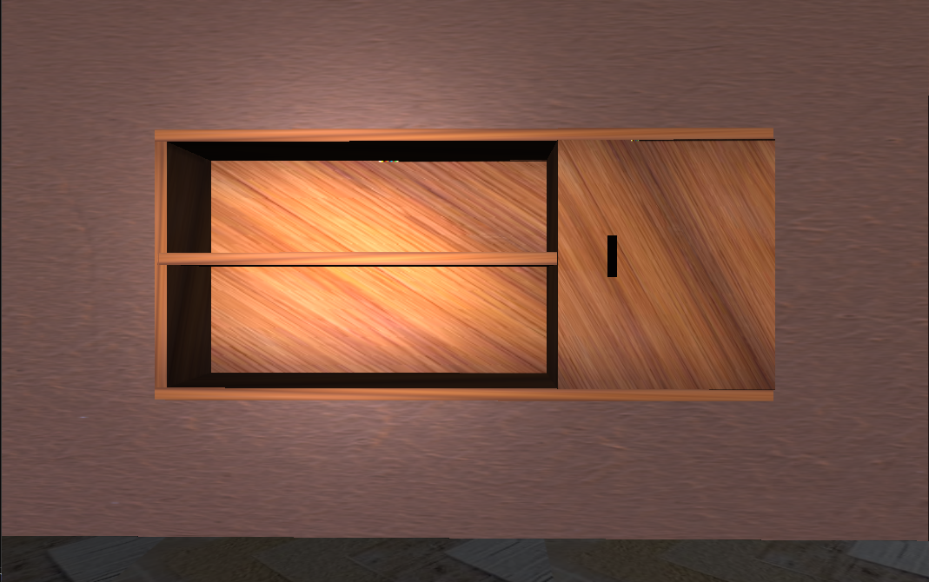
Snapshots
Figure 9: ShowCase View

Slide 11
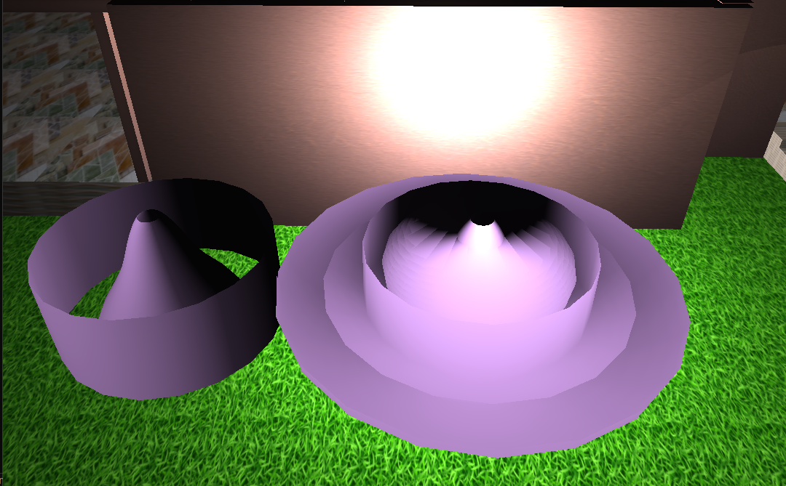
Snapshots
Figure 10: WaterFall using Bezier curve

Slide 12
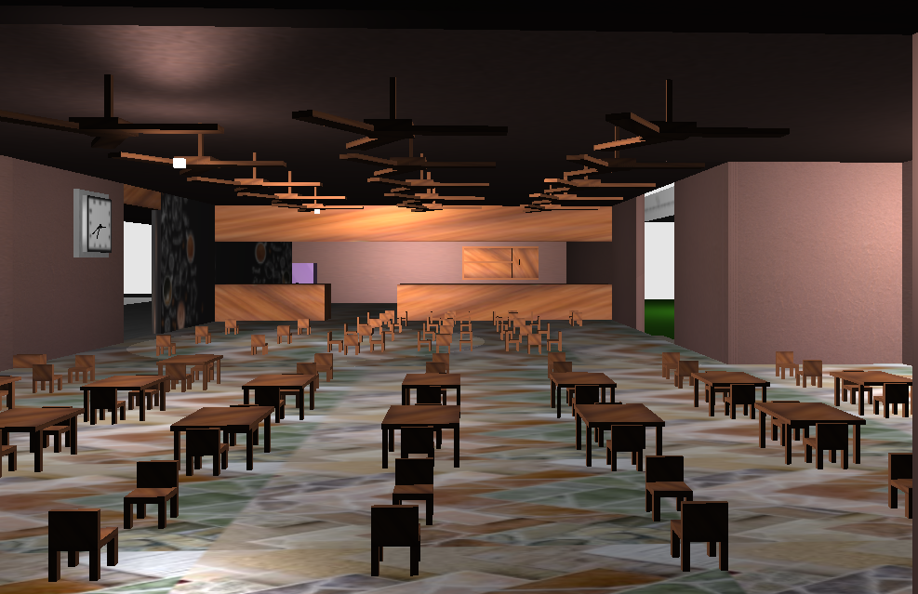
Snapshots
Figure 11: Entire Kitchen View

Slide 13
Thank You

